Slide 1
eGovernment in the Belgian social sector
co-ordinated by
the Crossroads Bank for Social Security

Slide 2
Origins of the CBSS initiative
stakeholders of the Belgian social sector
  > 11,500,000 citizens
  > 225,000 employers
  about 3,000 public and private institutions (actors) at several levels (federal, regional, local) dealing with
    collection of social security contributions
    delivery of social security benefits
      child benefits
      unemployment benefits
      benefits in case of incapacity for work
      benefits for the disabled
      re-imbursement of health care costs
      holiday pay
      old age pensions
      guaranteed minimum income
    delivery of supplementary social benefits
    delivery of supplementary benefits based on the social security status of a person

Slide 3
Origins of the CBSS initiative
a lack of well coordinated service delivery processes and of a lack of well coordinated information management led to
  a huge avoidable administrative burden and related costs for
    the citizens
    the employers/companies
    the actors in the social sector
  service delivery that didn’t meet the expectations of the citizens and the companies
  suboptimal effectiveness of social protection
  insufficient social inclusion
  too high possibilities of fraud
  suboptimal support of social policy
at the same moment there were
  a clear political will to solve those problems
  a scientifically well-founded solution based on the creation of a Crossroads Bank stimulating and coordinating business process re-engineering and electronic co-operation

Slide 4
Expectations of citizens and companies
effective social protection
integrated services
  attuned to their concrete situation, and personalized when possible
  delivered at the occasion of events that occur during their life cycle (birth, going to school, starting to work, move, illness, retirement, starting up a company, …)
  across government levels, public services and private bodies
attuned to their own processes
with minimal costs and minimal administrative burden
if possible, granted automatically
with active participation of the user (self service)
well performing and user-friendly
reliable, secure and permanently available
accessible via a channel chosen by the user (direct contact, phone, PC, …)
sufficient privacy protection

Slide 5
Gaining support
a clear long term vision combined with quick wins
federal Minister of Social Affairs as a political sponsor
demonstration of organisational and technical feasibility
gradual implication of
  the general managers of all public social security institutions
  the social partners managing the public social security institutions
  the general managers of the private social security institutions
successive formal approval of the vision and the initiative by
  all federal Ministers dealing with aspects of social security
  the federal Council of Ministers
  the National Labour Council (highest consultative body between the government and the social partners)
  the federal Parliament

Slide 6
Gaining support
small team in direct support of the federal Minister of Social Affairs
  consisting of
    experienced civil servants with a sound human network within all levels of the social sector
    scientific experts
    political advisors
  with multidisciplinary skills
    business process re-engineering
    change management
    legal
    ICT
    information security and privacy protection
    communication
    program and project management
gradually, co-operation agreements with other government levels (regions, local authorities, …)

Slide 7




The solution – concrete results and impact
Public Interest Companies
INASTI
ONSS
SFP
AIS
SPP IS
SIGeDIS
Regions and Communities
SPF E&TO
ORINT
Cities Municipalities Public social welfare centres
ONEM
FEDRIS
CIN
ONVA
INAMI
SPF SS

Slide 8
The solution – concrete results and impact
Internet
R
FedMAN
Users
R
Isabel
FW
R
…
R
Backbone
FW
FW
FW
FW
FW
R
R
R
R
R
ONEM
CBSS
ONSS
R
R
CIN
…

Slide 9
The solution – concrete results and impact
a network between all 3,000 social sector actors with a secure connection to the internet, the federal MAN, regional extranets, extranets between local authorities and the Belgian interbanking network
a unique identification key
  for every citizen
  for every company
  for every establishment of a company
an agreed division of tasks between the actors within and outside the social sector with regard to collection, validation and management of information and with regard to electronic storage of information in authentic sources

Slide 10
The solution – concrete results and impact
220 structured messages and 120 webservices for mutual information exchange amongst actors in the social sector, defined after process optimization
  nearly all direct or indirect (via citizens or companies) paper-based information exchange between actors in the social sector has been abolished
  in 2021, > 1,5 billion electronic messages were exchanged amongst actors in the social sector, which saved as many paper exchanges
electronic services for citizens
  maximal automatic granting of benefits based on electronic information exchange between actors in the social sector
  25 electronic services via an integrated portal and/or mobile applications

Slide 11
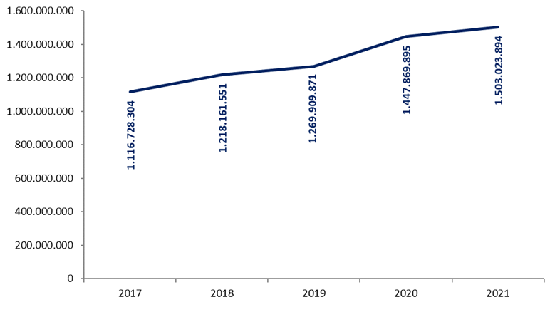
The solution – concrete results and impact
1.503.023.894 electronic messages were exchanged in 2021

Slide 12
The solution – concrete results and impact
more than 50 electronic services for employers, either based on the electronic exchange of structured messages or via an integrated portal site
  50 social security declaration forms for employers have been abolished
  in the remaining 30 (electronic) declaration forms the number of headings has on average been reduced to a third of the previous number
  declarations are limited to 3 events
    immediate declaration of recruitment and discharge (only electronically)
    quarterly declaration of salary and working time (only electronically)
    occurrence of a social risk (electronically or on paper)
  in 2021, more than 45 million electronic declarations were made by all 225,000 employers, 98 % of which from application to application

Slide 13
The solution – concrete results and impact
an integrated portal site and mobile applications containing
  electronic transactions for citizens, employers and professionals
  simulation environments
  information about the entire social security system
  harmonized instructions and information model relating to all electronic transactions
  a personal page for each citizen, each company and each professional
an integrated multimodal contact centre supported by a customer relationship management tool
a data warehouse containing statistical information with regard to the labour market and all branches of social security

Slide 14
Useful legislative changes
legal translation of
  the common vision on information management
  the common vision on information security and privacy protection
  the obligation to use unique identification keys
creation of a public institution (CBSS) that acts as a driving force
  mission and tasks
  governance
  financing principles
creation of a committee on information security and privacy protection
probative value of electronic information storage and exchange
punishment of abuse of the system
gradually, coordination or harmonisation of basic legal concepts
gradually, adaptation of business processes set out in the law

Slide 15
Implementation order used in Belgium
common vision on information management and information security
demonstration of feasibility
political and public support, support of the social partners, support of the social security institutions
basic legislation
  creating an institution as a driving force and a committee on information security and privacy protection
  translating the common vision on information management and information security
integration of unique identification key in all information systems
implementation of the ICT architecture and the basic ICT services
controlled access to databases with authentic data
re-engineering of processes between actors in the social sector at all government levels
re-engineering of processes between actors in the social sector and companies
re-engineering of processes between actors in the social sector and citizens
always combined with the necessary legislative changes

Slide 16
Critical success factors and obstacles
common vision on electronic service delivery, information management and information security amongst all stakeholders
support of and access to policymakers at the highest level
trust of all stakeholders, especially partners and intermediaries, based on
  mutual respect
  real mutual agreement
  transparency
respect for legal allocation of competences between actors
co-operation between all actors concerned based on distribution of tasks rather than centralization of tasks
focus on more efficient and effective service delivery and on cost control
reasoning in terms of added value for citizens and companies rather than in terms of legal competences

Slide 17
Critical success factors and obstacles
electronic service delivery as a structural reform process
  process re-engineering within and across actors
  back-office integration for unique information collection, re-use of information and automatic granting of benefits
  integrated and personalized front-office service delivery
multidisciplinary approach
  business process optimization
  legal coordination
  ICT coordination
  information security and privacy protection
  change management
  communication
  coaching and training
lateral thinking when needed
appropriate balance between efficiency on the one hand and information security and privacy protection on the other
quick wins combined with long term vision
technical and semantic interoperability

Slide 18
Critical success factors and obstacles
legal framework
adaptability to an ever changing societal and legal environment
creation of an institution that stimulates, co-ordinates and assures a sound program and project management
availability of skills and knowledge => creation of an association that hires ICT-specialists at normal market conditions and puts them at the disposal of the actors in the social sector
sufficient financial means for innovation: agreed possibility to re-invest efficiency gains in innovation
service oriented architecture (SOA)
need for radical cultural change within government, e.g.
  from hierarchy to participation and team work
  meeting the needs of the customer, not the government
  empowering rather than serving
  rewarding entrepreneurship within government
  ex post evaluation on output, not ex ante control of every input

Slide 19
Advantages
gains in efficiency
  in terms of cost: services are delivered at a lower total cost
    due to
      a unique information collection using a common information model and administrative instructions
      a lesser need to re-encoding of information by stimulating electronic information exchange
      a drastic reduction of the number of contacts between actors in the social sector on the one hand and companies or citizens on the other
      a functional task sharing concerning information management, information validation and application development
      a minimal administrative burden
    according to a study of the Belgian Planning Bureau, rationalization of the information exchange processes between the employers and the social sector implies an annual saving of administrative costs of about 1.7 billion € a year for the companies

Slide 20
Advantages
gains in efficiency
  in terms of quantity: more services are delivered
    services are available at any time, from anywhere and from several devices
    services are delivered in an integrated way according to the logic of the customer
  in terms of speed: the services are delivered in less time
    benefits can be allocated quicker because information is available faster
    waiting and travel time is reduced
    companies and citizens can directly interact with the competent actors in the social sector with real time feedback

Slide 21
Advantages
gains in effectiveness: better social protection
  in terms of quality: same services at same total cost in same time, but to a higher quality standard
  in terms of type of services: new types of services, e.g.
    push system: automated granting of benefits
    active search of non-take-up using data warehousing techniques
    controlled management of own personal information
    personalized simulation environments
better support of social policy
more efficient combating of fraud

Slide 22
Common vision on information management
information is being modelled in such a way that the model fits in as closely as possible with the real world, in order to allow multifunctional use of information
information is collected from citizens and companies only once by the social sector as a whole, via a channel chosen by the citizens and the companies, preferably from application to application, and with the possibility of quality control by the supplier before the transmission of the information
the collected information is validated once according to established task sharing criteria, by the actor that is most entitled to it or by the actor which has the greatest interest in correctly validating it
a task sharing model is established indicating which actor stores which information as an authentic source, manages the information and maintains it at the disposal of the authorized users

Slide 23
Common vision on information management
information can be flexibly assembled according to ever changing legal concepts
every actor has to report probable errors of information to the actor that is designated to validate the information
every actor that has to validate information according to the agreed task sharing model, has to examine the reported probable errors, to correct them when necessary and to communicate the correct information to every known interested actor
once collected and validated, information is stored, managed and exchanged electronically to avoid transcribing and re-entering it manually
electronic information exchange can be initiated by
  the actor that disposes of information
  the actor that needs information
  the CBSS that manages the interoperability framework

Slide 24
Common vision on information management
electronic information exchanges take place on the base of a functional and technical interoperability framework that evolves permanently but gradually according to open market standards, and is independent from the methods of information exchange
available information is used for
  the automatic granting of benefits
  prefilling when collecting information

Slide 25
Common vision on information security
security, availability, integrity and confidentiality of information is ensured by integrated structural, institutional, organizational, HR, technical and other security measures according to agreed policies
personal information is only used for purposes compatible with the purposes of the collection of the information
personal information is only accessible to authorized actors and users according to business needs, legislative or policy requirements
the access authorization to personal information is granted by an Sectoral Committee of the Privacy Commission, designated by Parliament, after having checked whether the access conditions are met
the access authorizations are public

Slide 26
Common vision on information security
every actual electronic exchange of personal information has to pass an independent trusted third party (basically the CBSS) and is preventively checked on compliance with the existing access authorizations by that trusted third party
every actual electronic exchange of personal information is logged, to be able to trace possible abuse afterwards
every time information is used to take a decision, the information used is communicated to the person concerned together with the decision
every person has right to access and correct his/her own personal data
every actor in the social sector disposes of an information security officer with an advisory, stimulating, documentary and control task

Slide 27
Useful tool: the reference directory
reference directory
  directory of available services/information
    which information/services are available at any actor depending on the capacity in which a person/company is registered at each actor
  directory of authorized users and applications
    list of users and applications
    definition of authentication means and rules
    definition of authorization profiles: which kind of information/service can be accessed, in what situation and for what period of time depending on in which capacity the person/company is registered with the actor that accesses the information/service
  directory of data subjects
    which persons/companies have personal files at which actors for which periods of time, and in which capacity they are registered
  subscription table
    which users/applications want to automatically receive what information/services in which situations for which persons/companies in which capacity

Slide 28
Useful tool: the electronic identity card
identification of the holder
  name
  Christian names
  nationality
  date and place of birth
  sex
  identification number of the National Register
  main residence
  manual signature
electronic authentication of the identity of the holder (private key and certificate)
possibility for the holder to sign electronically (private key and certificate)
no encryption certificate
no electronic purse
no biometric data

Slide 29
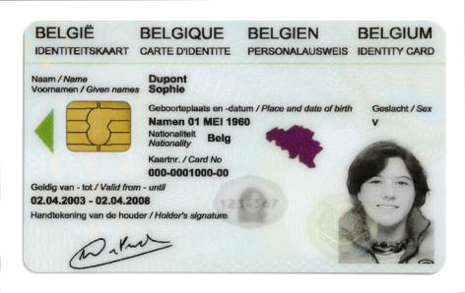
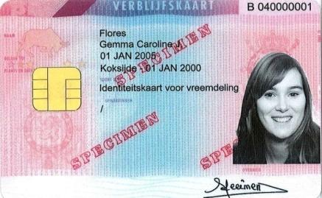
Integrated user and access management
Electronic identity card (eID): statutory electronic identity card for Belgians over the age of twelve
Kids-ID: on demand for children below the age of twelve
Foreigners card: for both EU and non-EU citizens with residence in Belgium

Slide 30
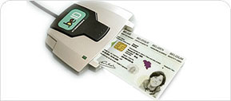
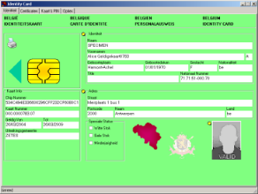
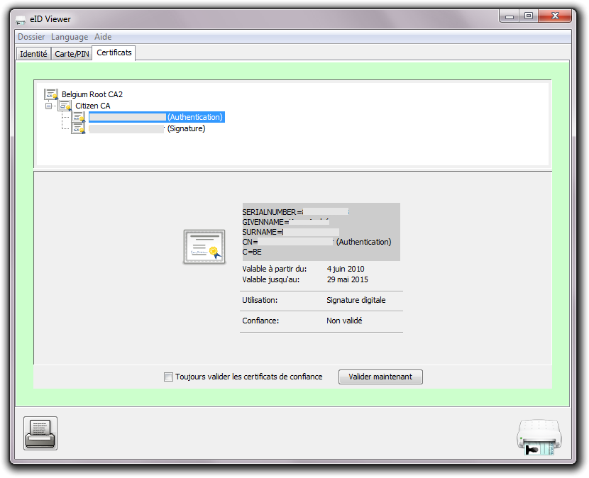
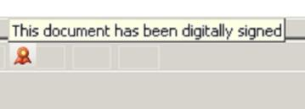
Electronic identity card (eID)
read data
authenticate identity
digital signatures

Slide 31

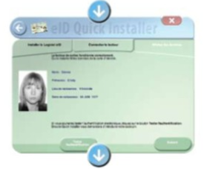
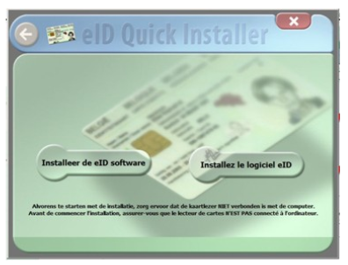
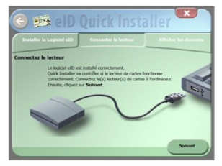
Electronic identity card (eID)
install eID software
connect the card reader with the computer
consult your data

Slide 32
Distributed information servers
information servers
  directory of data subjects at the Crossroads Bank
  basic identification data of citizens at the National Register and the complementary Crossroads Bank Register
  basic identification data of companies at the Company Register
  employers directory (WGR) at the ONSS
  work force register at the ONSS
  salary and working time database at the ONSS
  database of contribution certificates
services offered
  interactive consultation
  batch consultation
  automatic communication of updates

Slide 33
Pre-processed messages
pre-processed messages
  beginning/end of labour contract, beginning/end of self-employed activity
  contribution certificates medical care (employees, self-employed, beneficiaries of social security allowances)
  unemployment benefits
  benefits in case of career break
  benefits in case of incapacity for work ((labour) accident, (occupational) disease)
  reimbursement of health care costs
  child benefits
  old age pensions
  holiday pay
  benefits for the disabled
  guaranteed minimum income – social welfare
  derived rights (e.g. tax reduction/exemption, free public transport, ...)
  migrant workers
  …
services offered
  interactive consultation
  batch consultation
  automatic communication of messages

Slide 34








Quartely declaration salary & working time
simplification
Activity 3
Activity 2
Activity 1
employer
one electronic
declaration
ONSS
INAMI
ONEM
old age pension
SFP
holiday pay
ONVA

Slide 35
Declaration of social risks
types of social risks
  child benefits
  incapacity for work ((labour) accident, (occupational) disease, …)
  unemployment
  old age pension
3 possible moments of declaration
  start of the social risk
  recurrence or continuation of the social risk
  end of the social risk
structure of the declaration
  identification data
  if necessary, salary and working time data not yet declared via a quarterly declaration (mini-declaration)
  specific data concerning the social risk

Slide 36
LIMOSA
integrated electronic service delivery based on a single, mandatory declaration in case of temporary or partial professional activities of foreign employees and self-employed persons in Belgium
800.000 declarations per year
reduction of process time from 7 days to 5 minutes
integrated service throughout 8 types of institutions (750 concrete institutions)
gains in effectiveness
  improvement of social protection of migrant workers
  enhancement of free movement of workers and services
gains in efficiency
  lower cost due to single, multifunctional and electronic information collection and integrated information processing
  shortening of clearance times with immediate return of receipt
  availability of integrated services according to the logic of the user at any time and from anywhere
gains in transparency
  permanent access for the user to the processing status of its declaration

Slide 37
Institutional structure & financing of the CBSS
cooperative governance
adequate management and control techniques
financing principles
internal organization

Slide 38
CBSS as driving force
mission
  definition of the vision and the strategy on eGovernment in the social sector
  definition of the common principles related to information management, information security and privacy protection
  definition, implementation and management of an interoperability framework
    technical: secure messaging of several types of information (structured data, documents, images, metadata, …)
    semantic: harmonization of concepts and co-ordination of necessary legal changes
    business logic and orchestration support
  coordination of business process reengineering
  stimulation of service oriented applications
  driving force of the necessary innovation and change
  consultancy and coaching

Slide 39
Co-operative governance
CBSS has an innovative model of governance, steering the business process re-engineering with complex interdependencies between all actors involved
Board of Directors of the CBSS
  consists of representatives of the stakeholders (employers associations, trade unions, social security institutions, …)
  approves the strategic, operational and financial plans of the CBSS
General Coordination Committee with representation of all users acts as debating platform for the elaboration and implementation of eGovernment initiatives within the social sector
permanent or ad hoc working groups are instituted within the General Coordination Committee in order to co-ordinate the execution of programs and projects
the chairmen of the various working groups meet regularly as a Steering Committee
besides project planning and follow-up, proper measuring facilities are available to assure permanent monitoring and improvement after the implementation of the electronic services

Slide 40
Management and control techniques
annual priority plan debated with all users within the General Coordination Committee of the CBSS
cost accounting and zero-based budgeting resulting in financial transparency, an informed budget and a good evaluation of the management contract with the Belgian federal government
internal control based on the COSO-methodology (see www.coso.org) in order to provide reasonable assurance regarding the achievement of objectives with regard to
  effectiveness and efficiency of operations
  reliability of financial reporting
  compliance with applicable laws and regulations
external audit with regard to the correct functioning of the internal control system

Slide 41
Management and control techniques
program management through the whole social sector
issue management during the management of each program
use of a system of project management combined with a time keeping system to follow up projects that are realized by the CBSS and its partners
frequent reports to all users which describe the progress of the various projects and eventual adjustment measures
use of balanced scorecards and a dashboard to measure, follow-up and evaluate the performance of the electronic services and the CBSS
use of ITIL for ICT-service delivery
use of a coherent set of monitoring techniques to guarantee an optimal control and transparency of the electronic services

Slide 42
Financing principles
annual cost of the CBSS, its network and its services: 17.500.000 euro
financed by a withholding on the social security contributions paid by the employers, the employees and the self-employed before the distribution of these contributions to the social security sectors
no direct charge for the actors in the social sector in case of use of the CBSS services
  stimulation of the use of the system
  no additional accounting and administration costs for the social sector as a whole
charge per electronic message (0,0056 euro) exchanged for actors outside the social sector, with possibility of settlement on mutual terms in case of reciprocal information exchange

Slide 43
Internal organization CBSS
internal
  90 people
  General Management
  6 divisions
    R&D, Legal and External Communication
    Client, Program, Project and Services Management
    Application Development and Management
    ICT Management
    Information Security
    Resources Management (HR, finance, logistics, …)
co-sourced with association owned by the public social security institutions
  physical network
  some basic services (e.g. portal, contact centre, …)

Slide 44
Information security
structural and institutional measures
  no central data storage
  independent Information Security Committee
  within the social sector, a preventive control of the legitimacy of personal data exchange by CBSS according to the deliberations of the independent Information Security Committee
  information security department with each actor in the social sector
  specialized information security service providers
  information security working group
organizational and technical measures based on ISO 27XXX
legal measures

Slide 45
Independent Information Security Committee
designated by the Belgian Parliament
mandate
  information security supervision
  authorizing information exchange
  information security recommendations
  annual activity report

Slide 46
Information security department
with each social sector institution
composition
  data protection officer (DPO)
  one or more assistants
Information Security Committee enables the permanent education of the DPO’s
Information Security Committee can allow that a task of the information security department is outsourced to a recognized specialized information security service provider

Slide 47
Information security department
information security department
  recommends
  promotes
  documents
  controls
  reports directly to the executive management
  formulates the blueprint of the security plan
  elaborates the annual information security report
executive management
  takes decisions
  has the final responsibility
  gives motivated feedback
  approves the information security plan
  supplies the necessary resources

Slide 48
Annual information security report
general overview of the information security situation
overview of the activities
  recommendations and their effects
  control activities
  campaigns in order to promote information security
overview of the external recommendations and their effects
overview of the trainings received

Slide 49
Specialized information security service providers
to be recognized by the Government
recognition conditions
  non-profit association
  having information security in the social sector as the one and only activity
  respecting the tariff principles determined by the Government
tasks
  keeping information security specialists at the disposal of the associated actors
  recommending
  organizing information security trainings
  supporting campaigns promoting information security
  external auditing on request of the actor
  each actor can only associate with one specialized information security service provider

Slide 50
Information security working group
composition
  information security officers of all branches in the social sector
  sub-working groups
    branches
    themes (policy, audit, …)
tasks
  coordination
  creation of information security awareness
  communication
  formulating recommendations to the Information Security Committee
deliverables
  ISMS and information security policies
  minimum information security standards
  information security guidelines
  codes of good practice
  protecting the network
  organizing internal information security audits
  disaster recovery methods

Slide 51
Organizational & technical measures
risk assessment
security policies
governance and organization of information security
inventory and classification of information
human resources security
physical and environmental security
management of communication and service processes
processing of personal data
access control
acquisition, development and maintenance of information systems
information security incident management
business continuity management
compliance: internal and external control
communication to the public of the policies concerning security and the protection of privacy

Slide 52
Legal measures
obligations of the controller of the processing
  criteria for making data processing legitimate
  respect of basic privacy protection principles, such as the purpose limitation principle and the data minimisation principle
  specific rules for processing of sensitive data
  information to be given to the data subject
  processing confidentiality, integrity and availability
  notification of the processing of personal data
rights of the data subject
  right to information
  right to access
  right to rectify, erase or block his/her data
  right to a judicial remedy
sanctions and penalties

Slide 53

G-Cloud
https://www.gcloud.belgium.be/fr/index.html

Slide 54
G-Cloud
shared public ICT platform
  current target: federal state (FPS, PPP, Public Institutions of Social Security, Institutions of Public Benefit)
  can be extended to other interested authorities
hybrid community cloud model
  use of public cloud if possible
  private community cloud hosted in government managed data centers
  operational implementation with strong involvement of the private sector

Slide 55






Cloud deployment types
Hybrid
Public Cloud
Shared
Access/Control
Community Cloud on-premise
Outsourced Community Cloud (= off-premise)
Private Cloud on-premise
Outsourced Private Cloud (= off-premise)
Dedicated
Customer
Location
Service Provider

Slide 56
Basic principles
maximize synergy where possible, generate efficiency gains and/or savings, while maintaining or improving service quality to citizens / enterprises / public institutions
in line with overall synergy programme: assign services to the most capable one or propose shared services
synergy based on result orientation, sense of responsibility and mutual trust

Slide 57
Status G-Cloud service portfolio (26/11/2021)

Slide 58
G-Cloud organization
Government
G-Cloud Operations & Programme Board
G-Cloud Strategic Board
FPS/PPS
(Horizontal FPS, FPS FIN, Belnet, …)
PSSI/IPB
(CBSS, ...)
Association of FPS/PPSI/IPB
Private ICT companies directed by FPS/PSSI/...
3 Colleges
FPS
Public Institutions of Social Security (PIOSS)
Institutions of Public Benefit (IPB)
SIT: ICT managers from
FPS
Public Institutions of Social Security
Institutions of Public Benefit
Service
owners

Slide 59










Awards

Slide 60


More information
Website CBSS
https://www.ksz-bcss.fgov.be
Website of the data warehouse containing statistical information with regard to the labour market and all branches of social security
→ https://www.ksz-bcss.fgov.be/fr/dwh/homepage
Belgian Social Security portal
→ https://www.socialsecurity.be
frank.robben@mail.fgov.be
@FrRobben
https://www.frankrobben.be

